Slide 1

CAN YOU HANDLE THE PRESSURE?

Slide 2
MOVING THINGS WITH PRESSURE
What is Hydraulics?
The science of transporting of liquids through pipes, especially as
motive (motion) power. Nowadays we push fluid through piston and
Pipes to help us do work.
What is Pneumatics?
The science of of transporting of gas/air through pipes, especially as
motive (motion) power. Nowadays we push gas/air through piston and
Pipes to help us do work.

Slide 3
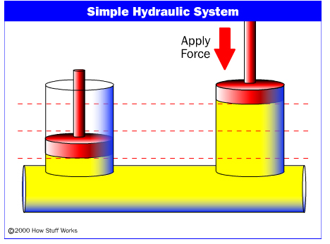
HYDRAULIC SYSTEM
A Simple hydraulic system consisting of two pistons and an oil-filled pipe connecting them.

Slide 4
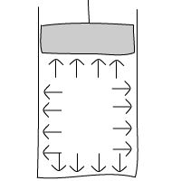
FLUID PRESSURE
FLUIDS: Materials that flow like liquids & gases
PRESSURE ~ FORCE
FLUID PRESSURE: Exerted in all directions equally
CONFINED FLUIDS: Any fluid in a closed system.
The fluids can move around within the system, but cannot leave or enter the system.
EXAMPLES: Blood moving through the body,
Air moving in a balloon
Pascal discovered that “ the pressure put upon an enclosed fluid is transmitted equally in all directions without loss and acts with an equal intensity upon equal surfaces.”

Slide 5
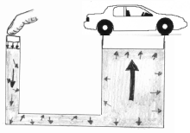
FLUID PRESSURE Cont …
The small syringe is easier to push, but it doesn’t
Make much movement in the other one!
The force applied to the small piston produces a greater
Force in a larger piston, but with less movement.
Force on the fluid in a small cylinder (usually supplied by an air compressor) is greatly increased in the “slave” cylinder since the diameter is larger. The only drawback is that the distance the small cylinder must go is greater and
the slave cylinder moves only a short distance.
Small force can move a car!

Slide 6
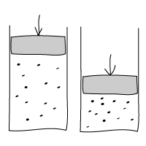
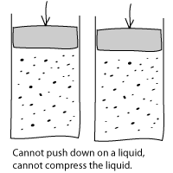
DIFFERENCE BETWEEN HYDRAULICS & PNEUMATICS
Hydraulics uses water and pneumatics uses air.
Gases
- Very compressible
- Gas particles are very spread out
Liquids
- Not compressible
- Particles in a liquid are not as spread out as in a gas
Cannot push down on a liquid,
cannot compress the liquid.

Slide 7
PNEUMATICS
Confined pressurized systems that use moving air or other gases
Because gases can be compressed, there is a delay in the movement, the force
Need for Compressor
HYDRAULICS
Confined pressurized systems that use moving liquids
Liquids are not very compressible, there is not delay in the movement
Hydraulic Fluid: liquid inside system
Cylinder: Container holding liquid
Piston: Plunger moving inside cylinder
Pumps – moves liquid in a specific direction (usually against gravity)
Valves – Controls the flow of direction (allows flow in one direction)

Slide 8
EXAMPLES
Hydraulics in Everyday Use!
Robotic arms use hydraulics and small motors to make the same movements over and over.
Excavators can be fitted with a pneumatic jackhammer as well.
The arrows show the direction of movement of the pistons. The straight movement of the piston results in curved movement of the arm.
A scissor lift is used as a movable, elevating platform.

Slide 9
EXAMPLES CONT …
This simple parallel lifter lifts the platform horizontally.
A scissor lift uses a hydraulic syringe in a different direction. By pushing the plunger, the syringe pushes sideways, this movement is transferred with a lever to an upward motion.
A really simple lifter using one syringe and a platform attached with string.
Simple excavator
More Info: http://science.howstuffworks.com/hydraulic.htm

Slide 10
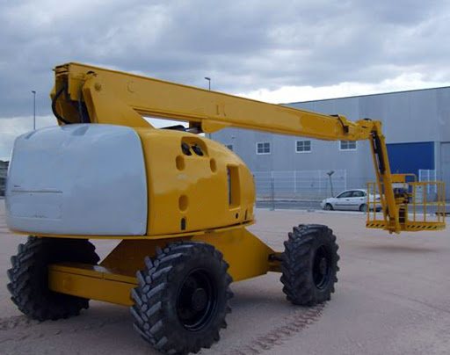

Hydraulic Cherry Picker
Uses
1. Building Maintenance
2. To Pick Fruit
3. Servicing Of Telephone And Electricity Poles
4. Filming Events Such As Large Sporting Competitions
5. Fire Services
6. In The Emergency Services
7. To Put Up Signs
8. In Recreation
9. Cutting Trees
10. Installing windows and Fixing Chimneys

Slide 11
Hydraulic Platform Lifter
Uses
Hydraulic lifts are used in a variety of different applications. They can be found in automotive, shipping, construction, waste removal, mining, and retail industries as they’re an effective means of raising and lowering people, goods, and equipment.

Slide 12
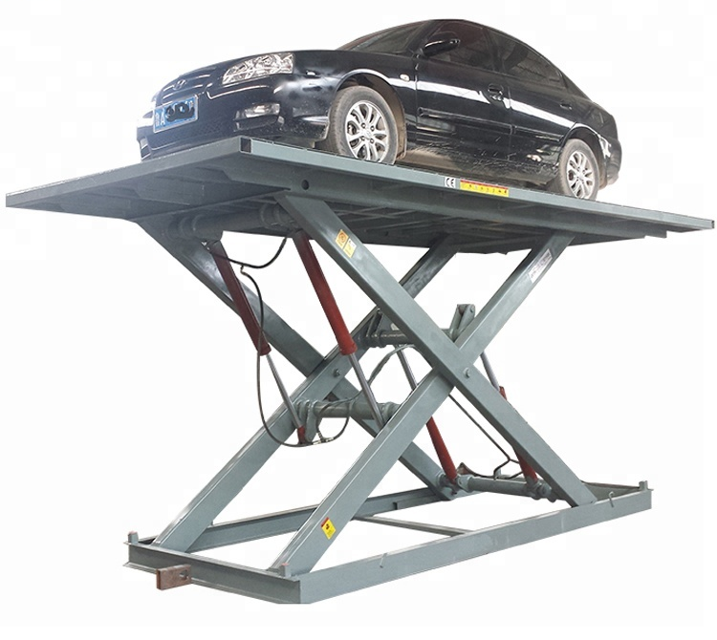
Hydraulic Scissor Lift
Uses
A hydraulic lift is a type of machine that uses a hydraulic apparatus to lift or move objects using the force created when pressure is exerted on liquid in a piston. Force then produces "lift" and "work.
Typical Uses of hydraulic lift:
Reaching Hard-to-Reach Places
Transporting and Tending to Patients
Loading and Unloading
Moving Workers
Transporting Goods

Slide 13
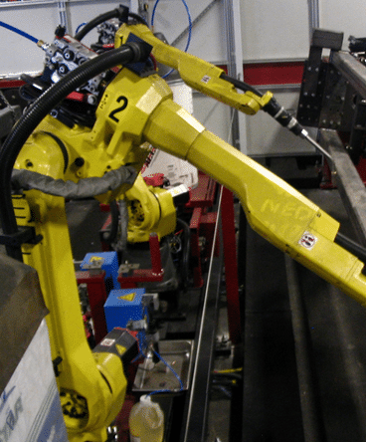
Hydraulic Robotic Arm Uses
The manufacturing world commonly uses the robotic arm to get the work done faster and more accurately.
It is ideally a metal arm with 4 to 6 joints and commonly used for various industrial applications. Industrial robot arms are like human arms and work in a similar way.
They have a forearm, elbow, shoulder, and wrist. It is referred to as the six-axis robot because it has 6 degrees or levels of freedom, allowing the user to move it in six different ways, although it differs from the human arm, which possesses 7 degrees of freedom

Slide 14
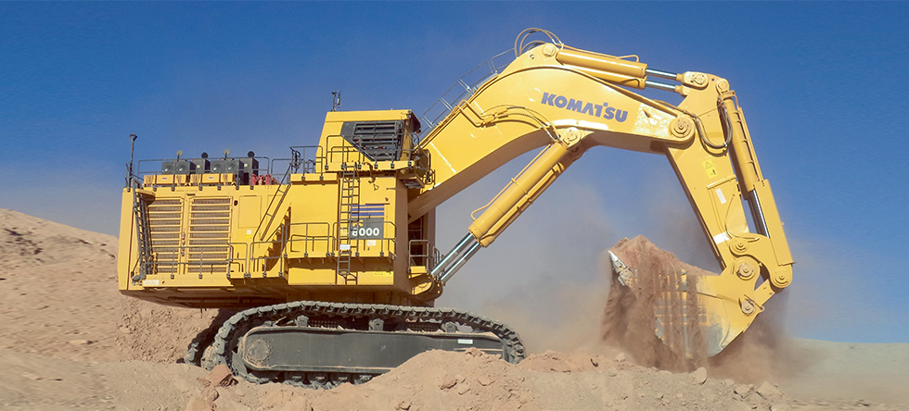
Hydraulic Excavator Uses
Usage of Excavator in Construction
The excavator probably is the most commonly used machine in the Construction Industry. There are many uses of an Excavator.
Digging of trenches, holes, foundations
Demolition
Material handling
General grading/landscaping
Brush cutting with hydraulic attachments
Forestry work
Lifting and placing of pipes
Mining, especially, but not only open-pit mining
River dredging

